Slide 1
Project Meeting 1
Cohort 2 Group 12:
Chok Hao Ze
Gong Chen
Lim Theck Sean
Oh Huan Xuan
Tang Mingzheng Paul

Slide 2
Project Requirements and Clarifications made
Game must be mobile
Game must be multiplayer
Game can be webapp
Does not need to solve an actual problem (eg. educate on climate change)
*We can approach SUTD Game Lab for technical assistance or loaning of devices.

Slide 3
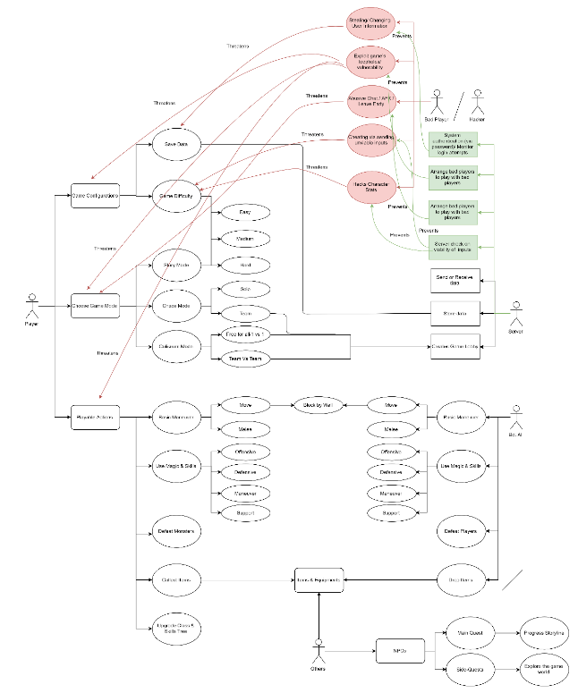
Use / Misuse Cases
Actors:
Player
Bot AI
Bad Player/ Hacker
Server
Others

Slide 4
Use Cases | Send movement / abilities inputs | Update game and send data | Game configuration | Receive data and render
Description | Players use on-screen joystick + buttons to send inputs to the server Enemy Bot can also move / cast abilities | Server receives incoming inputs from players, updates objects in the game accordingly, then sends back the data | Players are able to select game settings such as difficulty and game mode Players are also able to save their current game progress | Players receive data from server, and renders the sprites and various graphics accordingly
Actors | Player Enemy Bot | Server | Player Server | Player
Precondition | Internet connection on mobile device Player / Enemy is in-game | Server is up and game lobby exists | Player is in menu | Player is in-game
Procedure | Players can use the joystick and press buttons concurrently Inputs are sent to server Enemies have different programmed behaviours depending on type, player distance, etc | Server receives the data sent by users Server checks for collisions between various objects Server updates player and enemy data, map objects, projectiles Send updated data back to players | Players can select difficulty or game mode via navigating through menus / dropdown selections Settings are sent to and stored by Server | Players receive data such as coordinates, orientation, map objects, statuses etc New game state is rendered from preloaded assets
Post condition | Updated game state will be sent by server later | Players can render the next game state | Game stats and mode are saved and modified | Players are able to view the next game state

Slide 5
Misuse cases | Abusive chat / AFK / Leave game early | Cheating via sending unviable inputs to server | Stealing/ Changing User Information | Exploit game’s loopholes/ vulnerability
Actor | Bad player | Bad player | Bad player | Bad Player
Threatens | Player experience | Game update | Player experience/ Game’s playability | Player experience/ Game’s playability
Prevented by | Report system which is managed by server, reports sent by users | Server check on viability (eg. cooldowns on abilities) | System authentication (via password)/ Monitor login attempts | Regular system patches

Slide 6
Development Process
Iterative and incremental development
UI - Characters, Items, and Game World
Game Components
Code
Rapid Prototyping
UI: see if concept satisfactory, else redo.
Agile Methodologies & Principles
Working software is delivered frequently (weekly or biweekly basis)
Working software is principal measure of progress
Regular adaptation to changing circumstances
Simplicity - Art of maximising the work not done

Slide 7
Development Constraints & Risks
Latency Issues
UI constraints
Game with a fully developed storyline and world might take a lot of time.
Isometric or Top-Down time requirement
Inadequate knowledge/experience using Unity, C#, JS
Mobile platform performance constraints
Scalability
Game Difficulty
Multiplayer
Replayability

Slide 8
Workload Distribution
Game Graphics + Animation Design:
Gong Chen
Huan Xuan
Game Design, Story, Audio, Mechanics, miscellaneous
Hao Ze
Theck Sean
Backend Development
Paul
*Code will be contributed here and there by team members.

Slide 9
Project Timeline
Achieve playable game. Basic tiles, map, and character design. Finalised Main Quest development.
Tuning enemy design. Scaling game difficulty. Majority of game side-quests completed.
Blockchain Authentication. Increase game complexity. Game fine-tuning (graphics, storyline, and gameplay).
Final Presentation
Week 4
Week 7
Week 9
Week 13
Note: Project Meeting 2 is in week 5. Basic features of the game to be ready.
Week 6
Week 8
Week 10
Server latency issues. Scalability - stress test server. Further develop graphics. 50% of all required graphics.
Mid-Terms Week! Project Meeting 3. Test-cases implemented
Testing and fine-tuning, in preparation for project meeting 4

Slide 10
Thank You!

